Slide 1

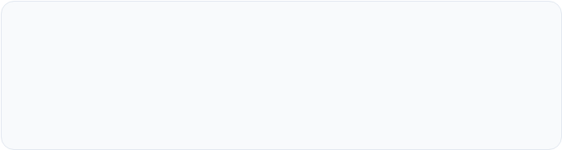
Valvie
Predicting structural valve deterioration
Paschalis Sarras — Electrical & Computer Engineering NTUA
Angeliki Sarra — Electrical & Computer Engineering NTUA
Athina Sarra — Medical Student UoA

Slide 2
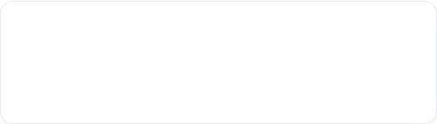
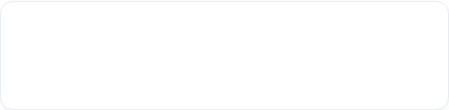
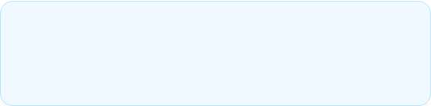
Problem
Core Challenge
12.6M
There is currently no reliable method to predict the lifespan of a bioprosthetic aortic valve using routine clinical data.
People globally living with calcific aortic valve disease (Yadgir et al., 2020)
14% → 47%
The Two Essential Questions
Durability: When will the valve fail? (Time-to-event)
Shift toward bioprosthetic valves between 1997–2014
Severity: How much has it already deteriorated? (VARC-3 staging)
8.2 Years
Median time to SVD in patients ≤50 years old

Slide 3




Data
Dataset Overview
Machine Learning Challenge
117 Total patients with unstructured clinical notes (Operative Reports, Progress Notes).
No Explicit Ground Truth: Absence of ready-made SVD labels or standardized failure timestamps.
< 10 Confirmed failure events (8-9 identified).
Data Sparsity: Full multimodal overlap (Labs + Meds + Notes) exists for only a small subset of the cohort.

Slide 4
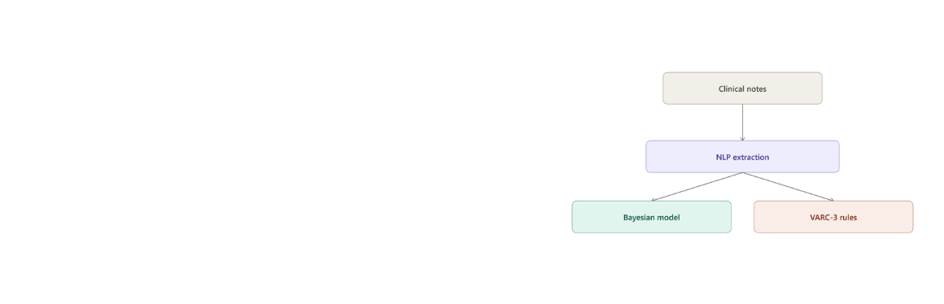
Our Model
Input: Physicians' clinical notes (free-text format).
NLP Extraction: Automatically extracts useful data (valve type, measurements, medical history) into a structured table.
Dual-Model Architecture:
Bayesian Model: Predicts how many years the valve will last.
Medical Rules (VARC-3): Determines the current stage of valve deterioration.

Slide 5
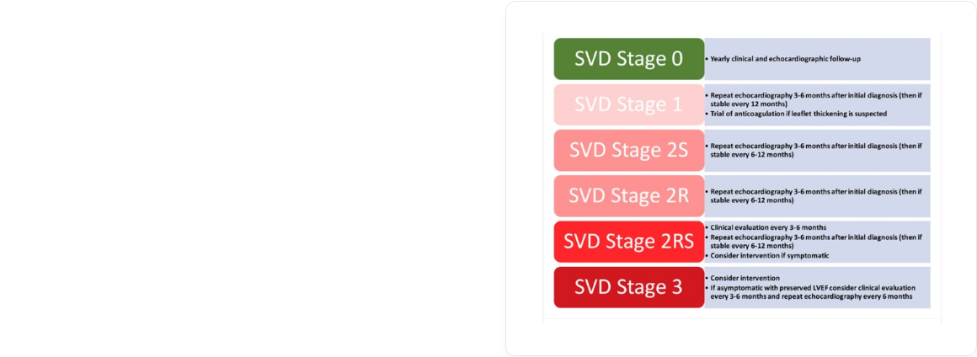
Innovation 1: Learning from Minimal Data
Literature-Informed Priors
Utilizing existing literature (Capodanno 2017, Trimaille 2025) instead of an unrealistic attempt to train from scratch.
Full Traceability
Every prediction is completely transparent and explainable. The model pinpoints exactly which clinical factors and specific text excerpts led to the estimation.

Slide 6
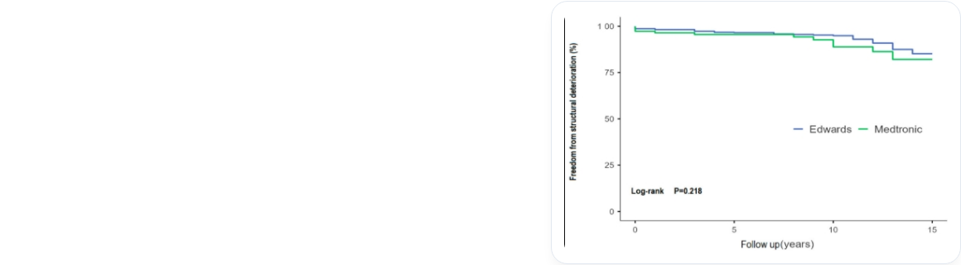
Innovation 2: More Data, No New Patients
We developed an algorithm that reconstructs individual patient data from published scientific survival curves.
We identified and utilized an open-source study of 918 patients specifically for SVD (Hlavička 2026).
This allows the model to learn from hundreds of additional cases, without requiring any new patient data collection.

Slide 7









Clinician's Contribution
Medical Guidance
Feature Selection
Data Annotation
Comprehensive explanation of the clinical background (SVD mechanisms, physiology) to the technical team, ensuring medical accuracy in our design.
Targeted guidance in selecting the most critical clinical variables that feed into the prediction model.
Specialized annotation of unstructured clinical notes, primarily focusing on confirming the presence of SVD and classifying its severity.

Slide 8


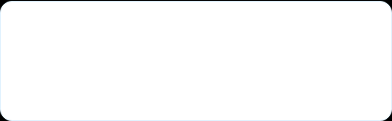
Results
100% Detection Rate: Successfully identified all 8 confirmed SVD cases in the original dataset (117 patients) — zero missed events.
Case Study
Patient_035
Biocor (2010) → ViV-TAVR (2024)
Reintervention Detector: Achieved 100% Recall and 80% Precision (F1-Score = 0.889).
Prediction: 15.2 yrs [80% CI: 13.1–19.3]
Actual Failure: 14 yrs

Slide 9
Thank You
Questions & Discussion
Paschalis Sarras | Angeliki Sarra | Athina Sarra

